Slide 1
Chapter7
Serial Devices

Slide 2
Serial devices
Terminal
Modem
Mice
…

Slide 3
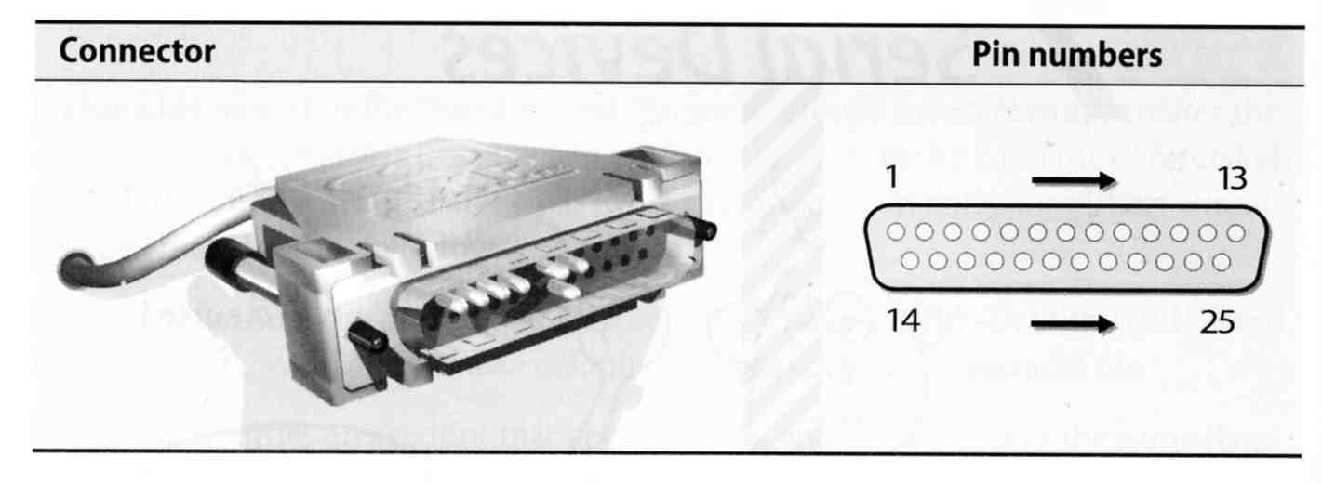
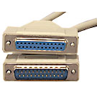
Serial standard (1)
RS-232 standard on DB25 connector
  Electrical characteristics
  Meaning of each signal wire
  Ping assignment
  DB25P (male)
  DB25S (female)

Slide 4
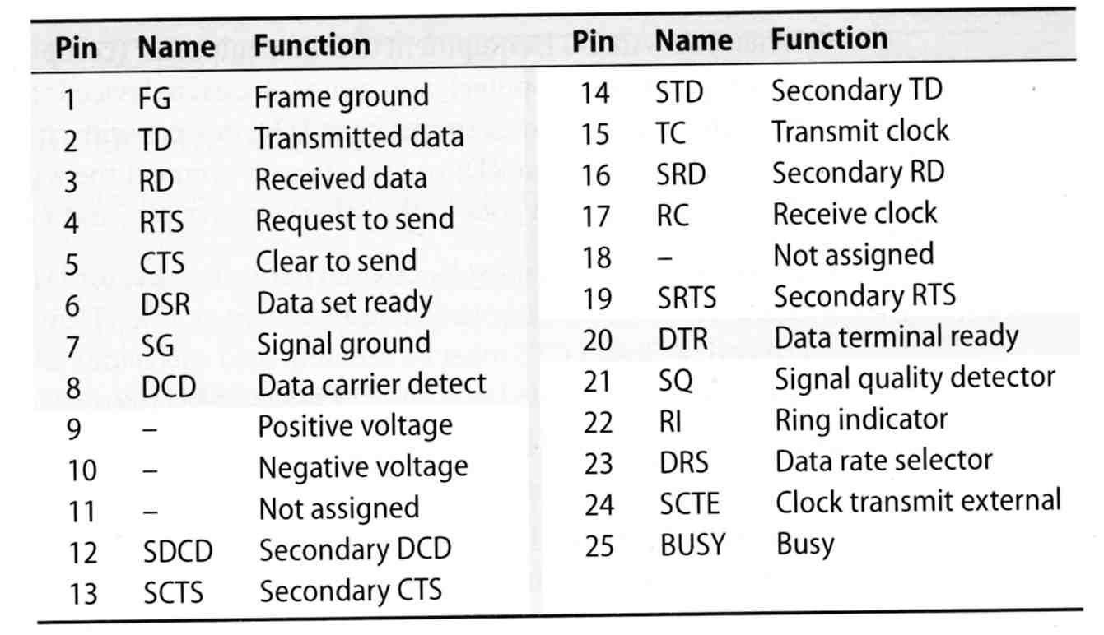
Serial standard (2)
RS-232 signals and ping assignment

Slide 5
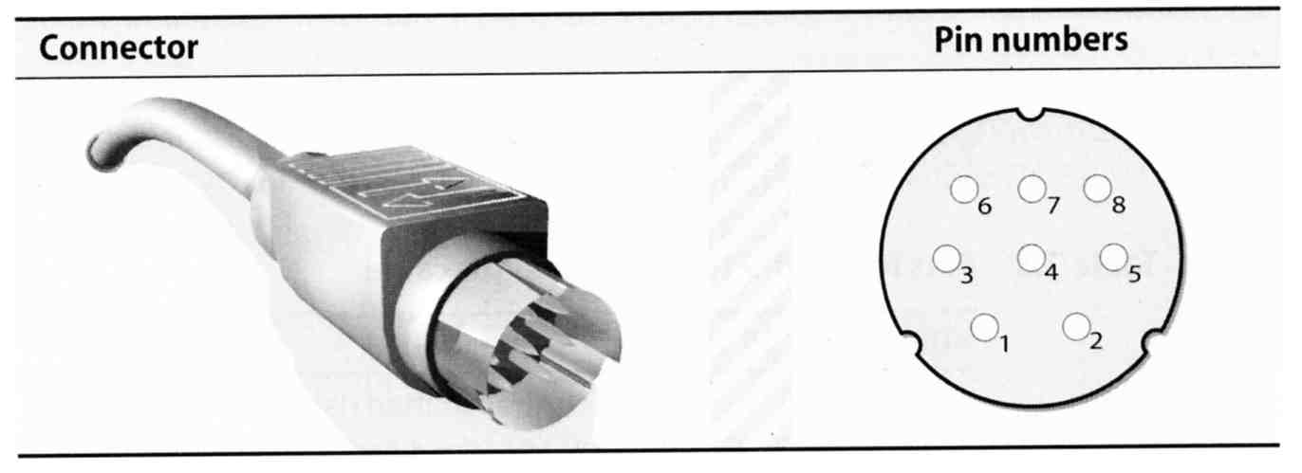
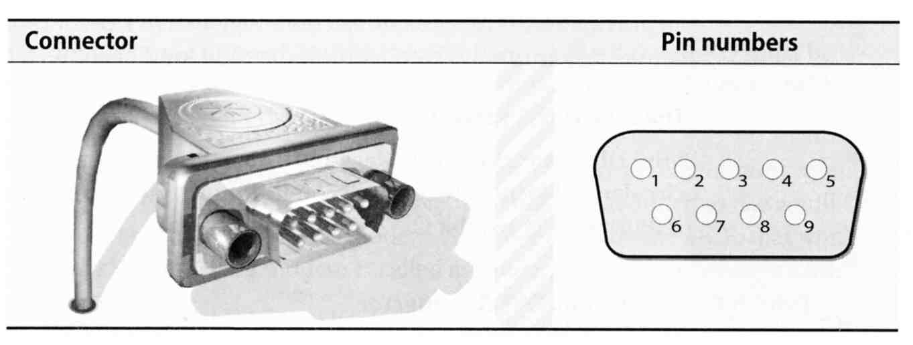
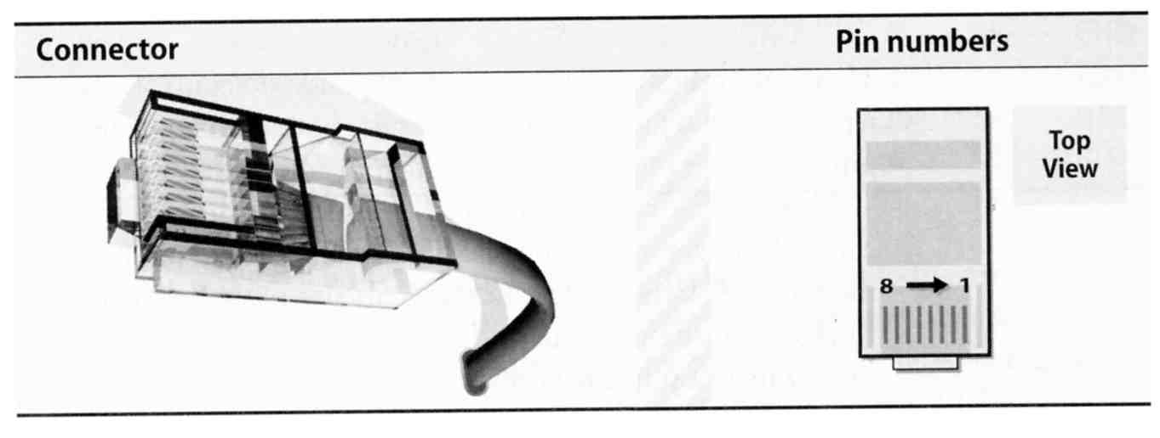
Serial standard (3)
Alternative connectors
  Since RS-232 is overkill for
  all real-world situation
    Mini DIN-8
    DB-9
    RJ-45

Slide 6
Serial standard (4)
Cable Length
  RS-232 specifies a maximum length of 75 feet at 9600 bps
    75 * 30.5 ≒ 22 m
  In reality, they hit the limit between 800 ~ 1000 feet

Slide 7
Serial Device File
Serial ports are represented by device files under /dev
The name of the device file is no big deal
  behavior is determined by the major and minor device number
System | Device files for the first two serial ports
FreeBSD | /dev/ttyd[0,1] (com1, com2)
Red Hat | /dev/ttyS[0,1]
Solaris | /dev/term[a,b]
SunOS | /dev/tty[a,b]
chwong@sabsd:/dev> ls -al ttyd*
crw------- 1 root wheel 28, 0 Sep 19 20:14 ttyd0
crw------- 1 root wheel 28, 1 Sep 19 20:14 ttyd1
crw------- 1 root wheel 28, 2 Sep 19 20:14 ttyd2
crw------- 1 root wheel 28, 3 Sep 19 20:14 ttyd3

Slide 8
Kernel Configuration
dmesg
  % /sbin/dmesg | grep sio
Kernel configuration file
  device sio
Kernel Module
  % kldload sio
sio0 <16550A-compatible COM port> port 0x2f8-0x2ff irq 3 on acpi0
sio0: type 16550A
sio1 <16550A-compatible COM port> port 0x2f8-0x2ff irq 3 on acpi0
sio1: type 16550A

Slide 9
Software Configuration
Depend on the type of serial device
  Hardwired terminal
  Modem

Slide 10
Configuration of
Hardwired Terminals (1)
Two main tasks
  Make sure each process is attached to a terminal to accept logins
  Make sure that information about the terminal is available once a user login

Slide 11
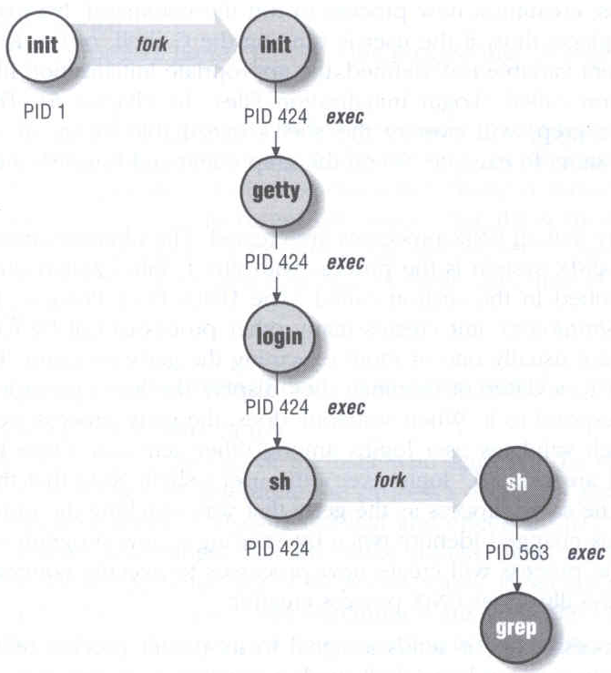
Configuration of
Hardwired Terminals (2)
The login process
  init spawn getty according to /etc/ttys
  getty sets the port’s initial characteristics and print the prompt
  User enter login name
  getty executes login program
  login request password
  login prints /etc/motd
  login sets up environment variables
  login runs a shell for user

Slide 12
Configuration of
Hardwired Terminals (3)
Terminal Configuration Files
  On/Off
    whether the terminal should be run a getty
  Term type
    virtual console, network, dial-in
  Parameter
    Terminal parameters, such as speed
System | On/Off | Term Type | Parameters | Monitor
FreeBSD | /etc/ttys | /etc/ttys | /etc/gettytab | getty
Red Hat | /etc/inittab | /etc/ttytype | /etc/gettydefs | getty
SunOS | /etc/ttytab | /etc/ttytab | /etc/gettytab | getty
Solaris | _sactab | _sactab | zsmon/_pmtab | ttymon

Slide 13
Configuration of
Hardwired Terminals (4)
FreeBSD: /etc/ttys
  Format
  device program termtype {on|off} [secure]
  Restart init process
    kill -1 1
    kill –HUP 1
ttyv1 "/usr/libexec/getty Pc" cons25 on secure
ttyv2 "/usr/libexec/getty Pc" cons25 on secure
ttyd0 "/usr/libexec/getty std.9600" dialup off secure
ttyd1 "/usr/libexec/getty std.9600" dialup off secure
ttyp0 none network
ttyp1 none network

Slide 14
Configuration of
Hardwired Terminals (5)
FreeBSD: /etc/gettytab
  Associate symbolic names with port configuration information,
  such as speed, parity, prompt
  man gettytab
default:\
:cb:ce:ck:lc:fd#1000:im=\r\n%s/%m (%h) (%t)\r\n\r\n:sp#1200:\
:if=/etc/issue:
2|std.9600|9600-baud:\
:np:sp#9600:
P|Pc|Pc console:\
:ht:np:sp#115200:
Notes:
sp: line speed
np: no parity
ht: terminal has real tabs
cb: use crt backspace mode
ce: use crt erase algorithm
ck: use crt kill algorithm
lc: terminal has lower case
fd: form feed delay
im: login prompt
if: display named file before prompt

Slide 15
Special Characters and The terminal driver
The terminal driver supports several special function when typing special keys
Name | Default | Function
Erase | ^H | Erases one character of input
WErase | ^W | Erases one word of input
Kill | ^U | Erases the entire line of input
EOF | ^D | Sends an “end of file” indication
INTR | ^C | Interrupts the currently running process
Quit | ^\ | Kills the current process with a core dump
Stop | ^S | Stops output to the screen
Start | ^Q | Restarts output to the screen
Discard | ^O | Throws away pending output
Suspend | ^Z | Suspends the current process
LNext | ^V | Interprets the next character literally

Slide 16
stty –
Set Terminal Options
Change and query various settings of the terminal drivers
  There are about a zillion options
  man tty(4) and stty(1)
Example
  stty intr "^C" kill "^U" erase "^H"
  stty –a
  reset tty
    reset
    stty sane
speed 38400 baud; 24 rows; 80 columns;
lflags: icanon isig iexten echo echoe -echok echoke -echonl echoctl
-echoprt -altwerase -noflsh -tostop -flusho pendin -nokerninfo
-extproc
iflags: -istrip icrnl -inlcr -igncr ixon -ixoff ixany imaxbel -ignbrk
brkint -inpck -ignpar -parmrk
oflags: opost onlcr -ocrnl -oxtabs -onocr -onlret
cflags: cread cs8 -parenb -parodd hupcl -clocal -cstopb -crtscts -dsrflow
-dtrflow -mdmbuf
cchars: discard = ^O; dsusp = ^Y; eof = ^D; eol = <undef>;
eol2 = <undef>; erase = ^?; erase2 = ^H; intr = ^C; kill = ^U;
lnext = ^V; min = 1; quit = ^\; reprint = ^R; start = ^Q;
status = ^T; stop = ^S; susp = ^Z; time = 0; werase = ^W;

Slide 17


Other Common I/O ports (1)
Parallel ports
  Similar to serial ports in concept, but parallel ports transfer 8 bits of data at once
  IEEE-1284 standard
  Male DB25 ←→ male Centronics connector
Female Centronics connector
Male Centronics connector

Slide 18
Other Common I/O ports (2)
USB – Universal Serial Bus
  Up to 127 devices can be connected
  Standardized connectors
  Devices can be connected and disconnected without powering down
  Up to 12Mb/s
USB 2.0
  Up to 480Mb/s

